Slide 1
Game Backend with Leaderboards
By Yazan Ezzedine IT-461-001 Final Project

Slide 2
Prompt:
Players submit scores and game stats via API Gateway. Scores and player profiles are stored in DynamoDB. Lambda calculates leaderboards and achievements. Game assets can reside in S3. SQS handles notifications about player rankings or challenges.

Slide 3
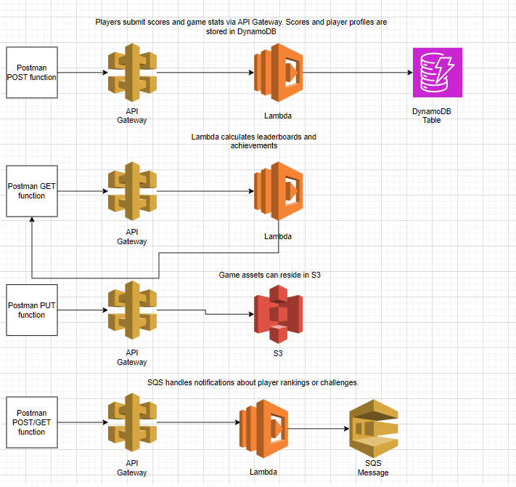
Services
Using the API Gateways, I’d create post, get, put, and delete functions in order to POST scores and names into DynamoDB, GET leaderboards and achievements and sort them from highest to lowest scores using the API Gateway and Lambda. PUT game assets (I could’ve chosen any file type but I chose to do images for this example) using the API gateway to put assets into an S3 Bucket. Finally, using both POST and GET to post a new score, and using the lambda function anytime anything is edited in the dynamoDB table I’ve created for the player options It gets posted as an SQS message alerting you of the change which can be viewed using the get function to see the new rankings.

Slide 4
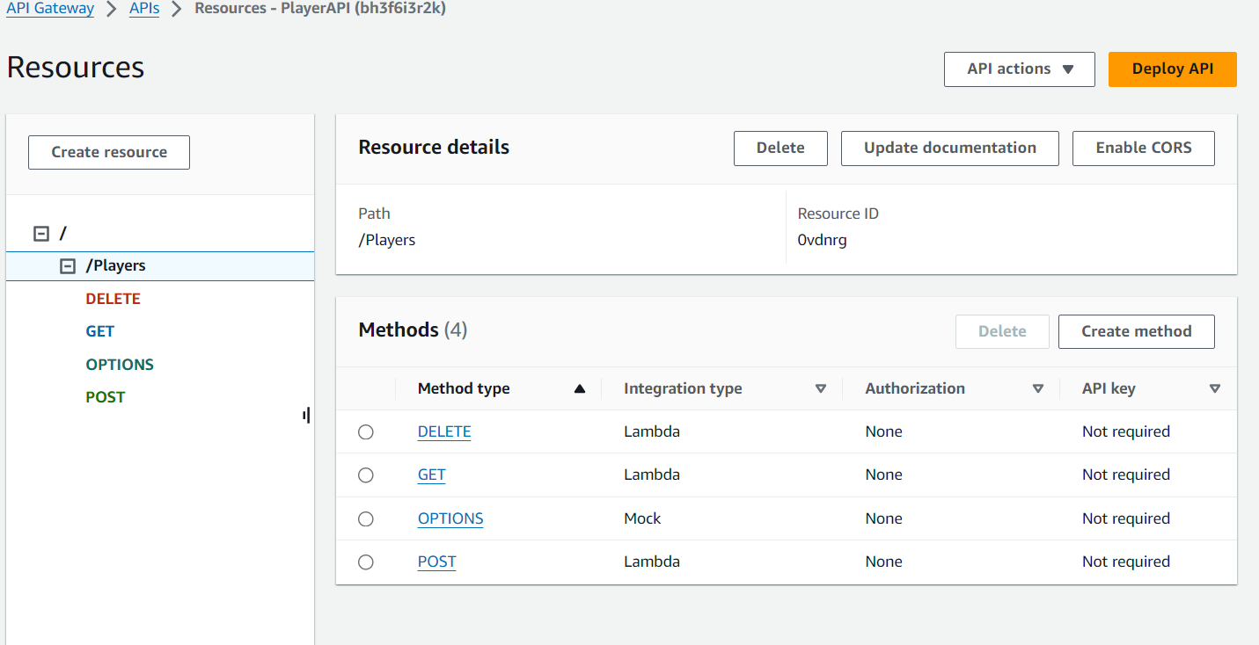
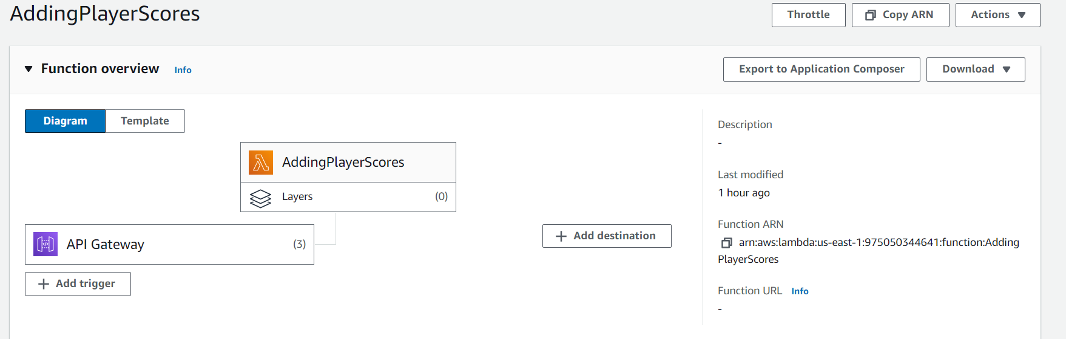
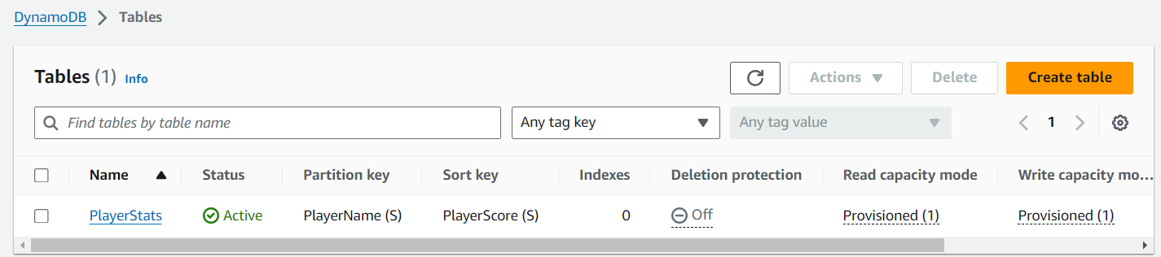
Solution for submitting scores
For the score submissions, I followed the professors instruction on importing the player name, and their score into a dynamoDB table using an API gateway and lambda function. The API Gateway allows you to GET, POST, and DELETE entries from the table which is exactly what we needed for this part of the project.

Slide 5
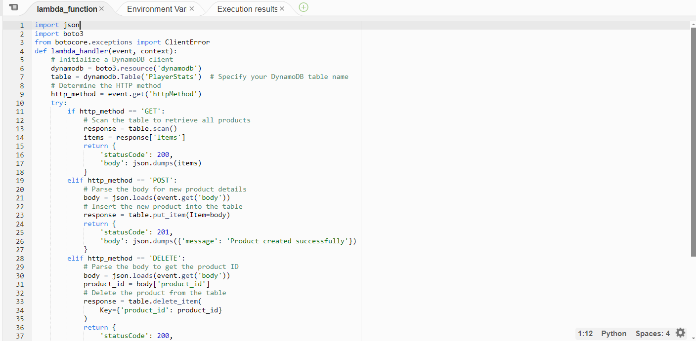
Lambda Code Snippet (From Professors Video)

Slide 6
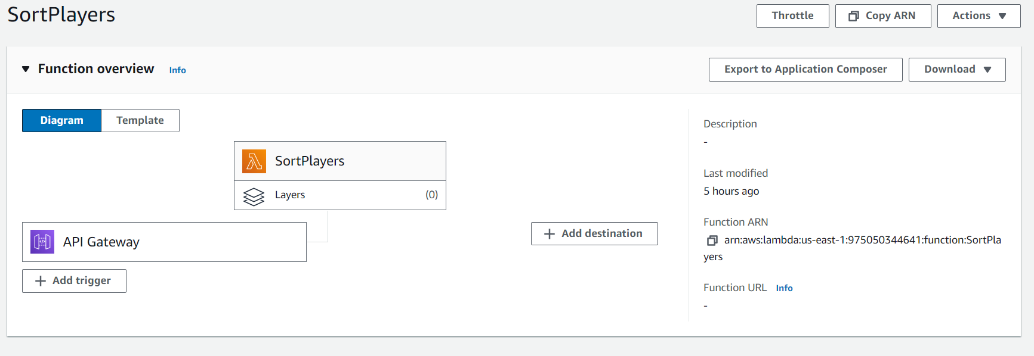
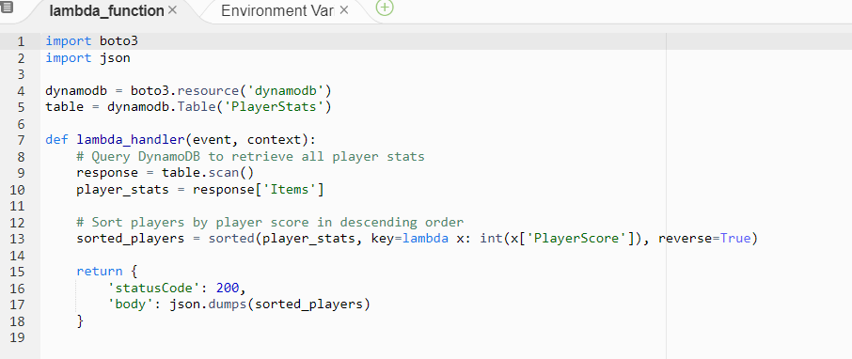
Solution for Lambda Calculating scores
I created a lambda function and API gateway that called the function using the GET method. The lambda function justs sorts the players by the player scores in order whenever it’s called.

Slide 7
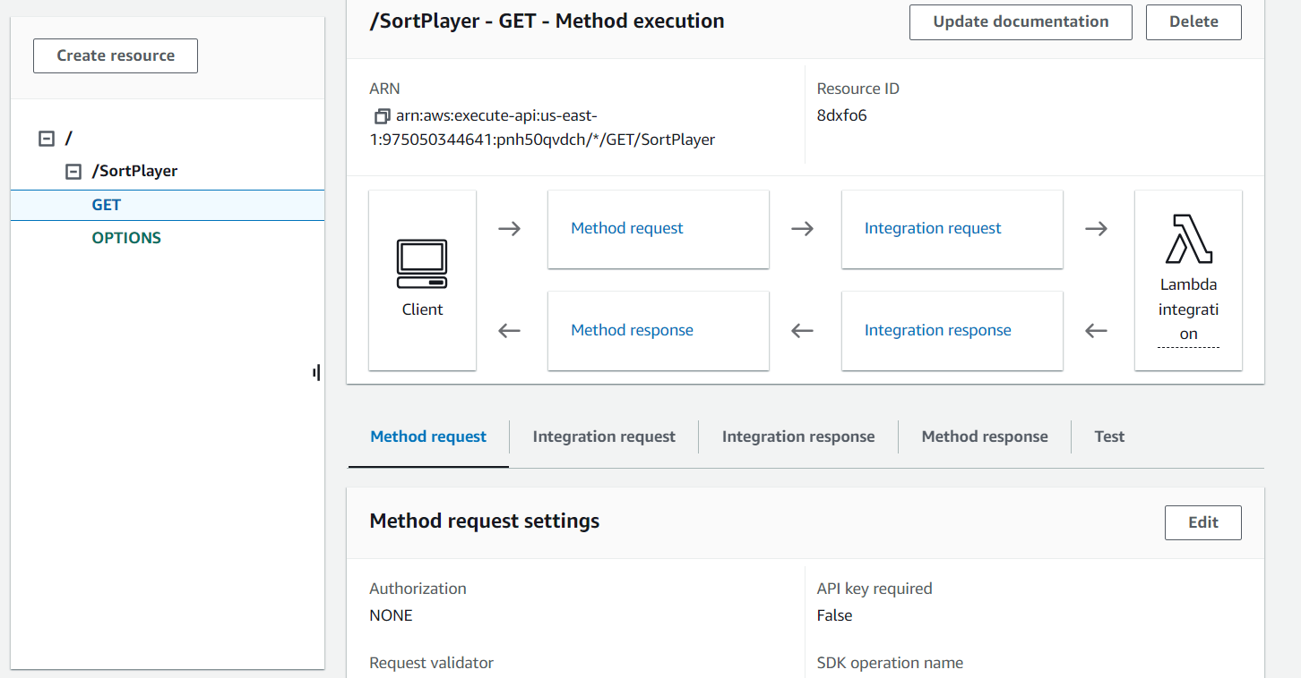
Solution for Lambda Calculations Cont.

Slide 8
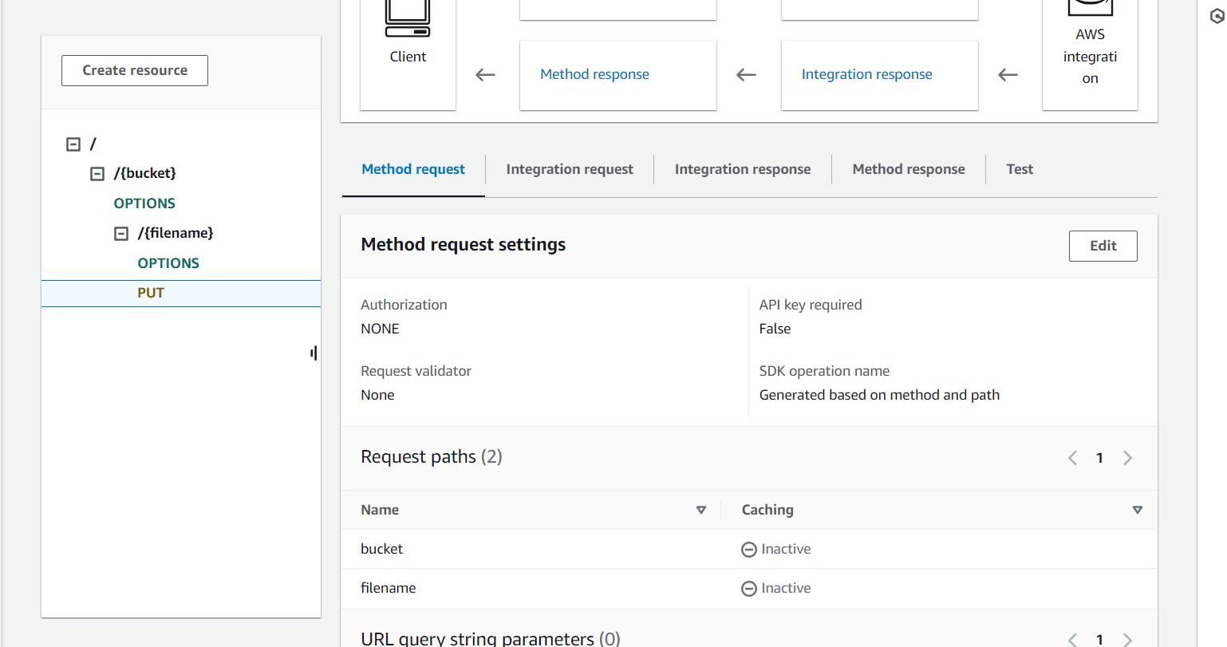
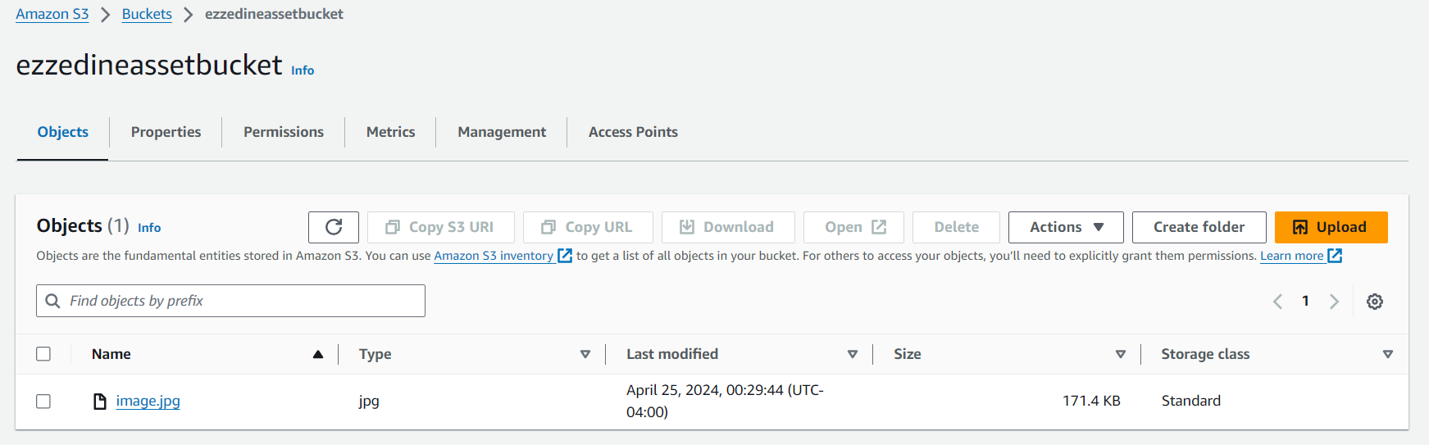
Game Assets in S3
I created an api gateway with a IAM role that only allows you to put objects directly into an S3 bucket using the PUT function on postman then set the binary media type to accept jpg images.

Slide 9
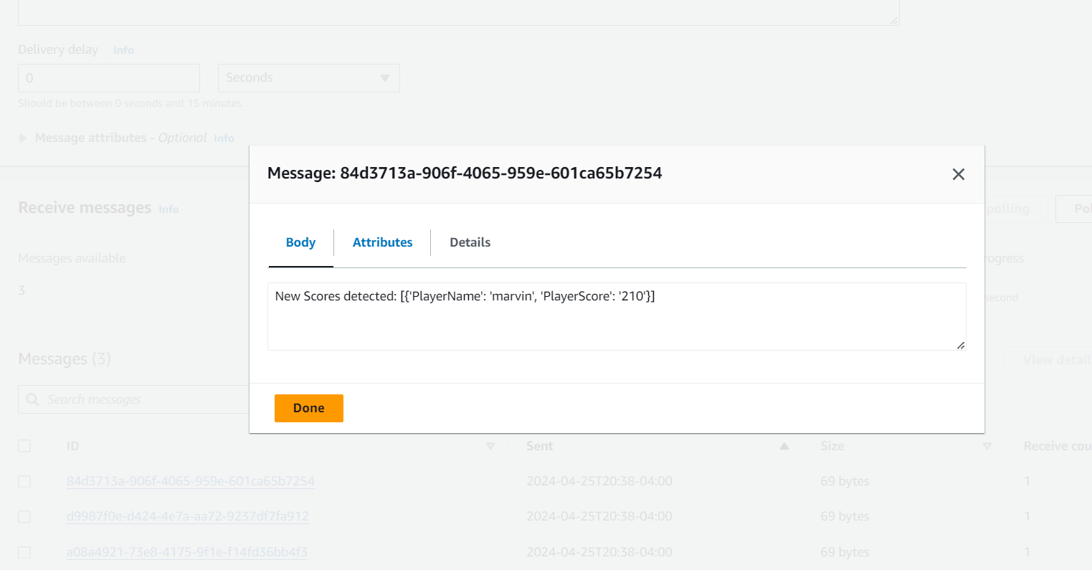
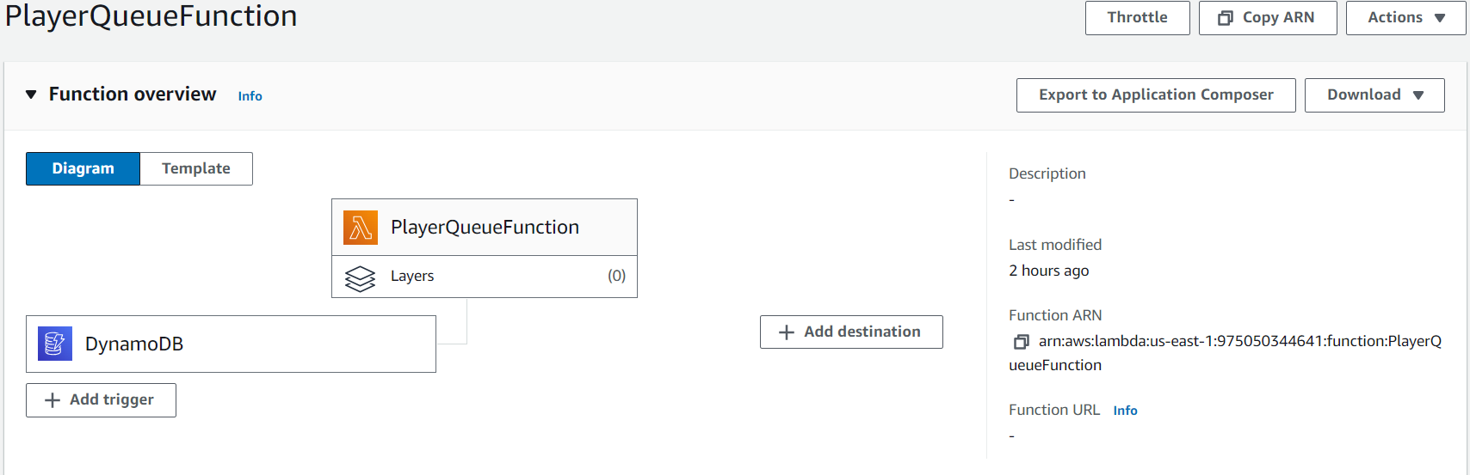
SQS Notifications.
I used a lambda function and SQS in order to receive messages anytime the dynamoDB table updated which showed us the new entry, and using the get function in the API Gateway on postman, it’ll show the updated scores in the order of highest to least.

Slide 10
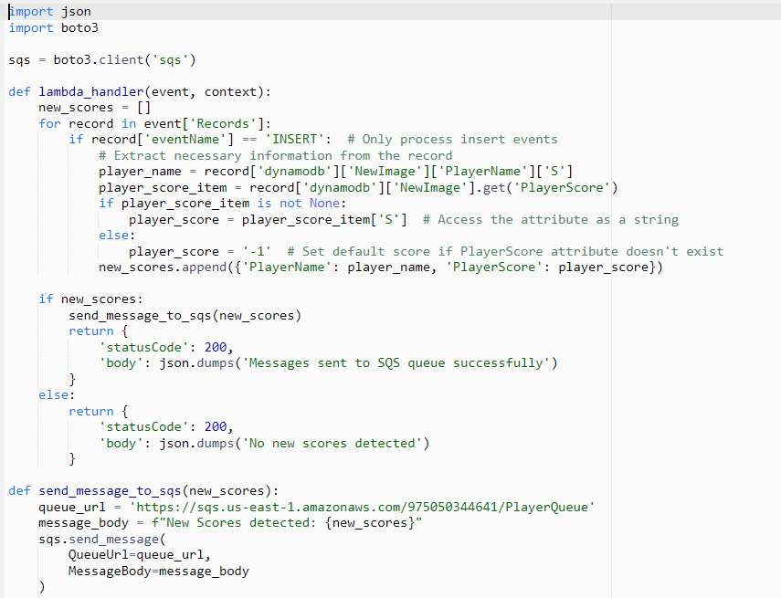
SQS Notifications Lambda Code

Slide 11
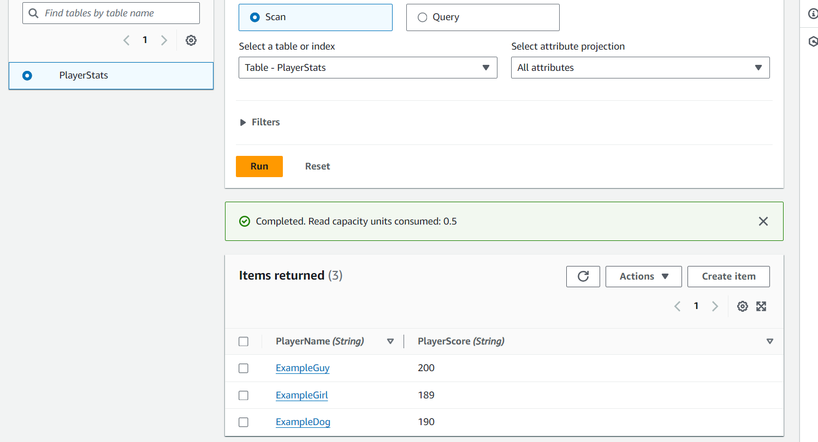
DynamoDB Table

Slide 12

Video Example of Project
Incase video doesn’t work, link to google drive of the video: https://drive.google.com/file/d/14z6c55vJES0zC2YdYpRuKebnEGPT8bRT/view?usp=sharing

